Slide 1


CSE3078 – Cryptography and Network Security
School of Computer Science and Engineering

Slide 2
Module 2
Private Key Cryptography and Number Theory

Slide 3
Data Encryption Standard (DES)
most widely used block cipher in world
adopted in 1977 by NBS-National Bureau of Standards (now NISTNational Institute of Standards and Technology)
as FIPS (FEDERAL INFORMATION PROCESSING STANDARDS PUBLICATION) PUB 46
encrypts 64-bit data using 56-bit key
has widespread use
has been considerable controversy over its security

Slide 4
DES History
IBM developed Lucifer cipher
by team led by Feistel
used 64-bit data blocks with 128-bit key
then redeveloped as a commercial cipher with input from NSA and others
in 1973 NBS issued request for proposals for a national cipher standard
IBM submitted their revised Lucifer which was eventually accepted as the DES

Slide 5
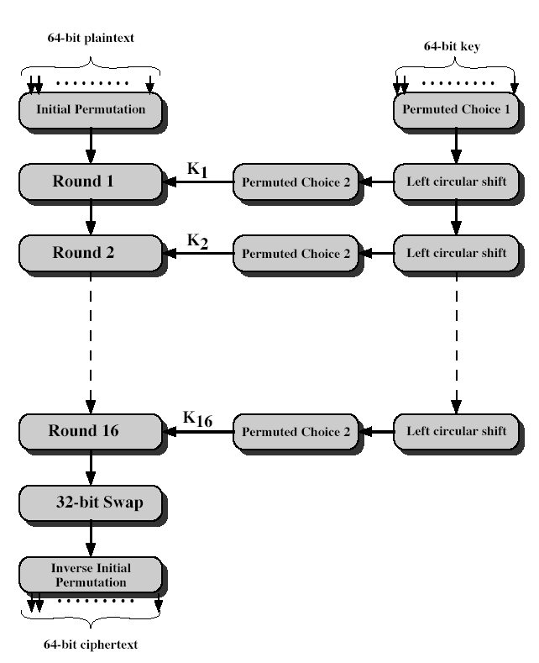
DES Encryption

Slide 6
Initial Permutation IP
first step of the data computation
IP reorders the input data bits
even bits to LH half, odd bits to RH half
quite regular in structure (easy in h/w)
example: IP(675a6967 5e5a6b5a) = (ffb2194d 004df6fb)

Slide 7
DES Round Structure
uses two 32-bit L & R halves
as for any Feistel cipher can describe as:
L_{i} = R_{i–1}
R_{i} = L_{i–1} xor F(R_{i–1}, K_{i})
takes 32-bit R half and 48-bit subkey and:
expands R to 48-bits using perm E
adds to subkey
passes through 8 S-boxes to get 32-bit result
finally permutes this using 32-bit perm P

Slide 8
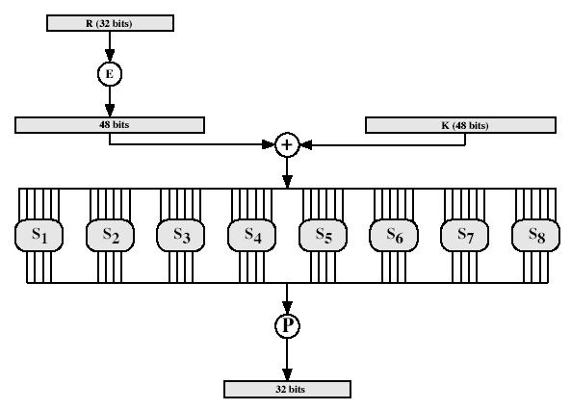
DES Round Structure

Slide 9
Substitution Boxes S
have eight S-boxes which map 6 to 4 bits
each S-box is actually 4 little 4 bit boxes
outer bits 1 & 6 (row bits) select one rows
inner bits 2-5 (col bits) are substituted
result is 8 lots of 4 bits, or 32 bits
row selection depends on both data & key
feature known as autoclaving (autokeying)
example: S(18 09 12 3d 11 17 38 39) = 5fd25e03

Slide 10
DES Key Schedule
forms subkeys used in each round
consists of:
initial permutation of the key (PC1) which selects 56-bits in two 28-bit halves
16 stages consisting of:
selecting 24-bits from each half
permuting them by PC2 for use in function f,
rotating each half separately either 1 or 2 places depending on the key rotation schedule K

Slide 11
DES Decryption
decrypt must unwind steps of data computation
with Feistel design, do encryption steps again
using subkeys in reverse order (SK16 … SK1)
note that IP undoes final FP step of encryption
1st round with SK16 undoes 16th encrypt round
….
16th round with SK1 undoes 1st encrypt round
then final FP undoes initial encryption IP
thus recovering original data value

Slide 12
Strength of DES – Key Size
56-bit keys have 2⁵⁶ = 7.2 x 10¹⁶ values
brute force search looks hard
recent advances have shown is possible
in 1997 on Internet in a few months
in 1998 on dedicated h/w (EFF) in a few days
in 1999 above combined in 22hrs!
still must be able to recognize plaintext
now considering alternatives to DES

Slide 13
Strength of DES – Timing Attacks
attacks actual implementation of cipher
use knowledge of consequences of implementation to derive knowledge of some/all subkey bits
specifically use fact that calculations can take varying times depending on the value of the inputs to it
particularly problematic on smartcards

Slide 14
Introduction to Finite Fields – Number Theory
Will now introduce finite fields
Of increasing importance in cryptography
AES, Elliptic Curve, IDEA, Public Key
Concern operations on “numbers”
where what constitutes a “number” and the type of operations varies considerably
Start with concepts of groups, rings, fields from abstract algebra

Slide 15
Group
a set of elements or “numbers”
with some operation whose result is also in the set (closure)
obeys:
associative law: (a.b).c = a.(b.c)
has identity e: e.a = a.e = a
has inverses a⁻¹: a.a⁻¹ = e
if commutative a.b = b.a
then forms an abelian group

Slide 16
Cyclic Group
define exponentiation as repeated application of operator
example: a⁻³ = a.a.a
and let identity be: e=a⁰
a group is cyclic if every element is a power of some fixed element
ie b = a^{k} for some a and every b in group
a is said to be a generator of the group

Slide 17
Ring
a set of “numbers”
with two operations (addition and multiplication) which form:
an abelian group with addition operation
and multiplication:
has closure
is associative
distributive over addition: a(b+c) = ab + ac
if multiplication operation is commutative, it forms a commutative ring
if multiplication operation has an identity and no zero divisors, it forms an integral domain

Slide 18
Field
a set of numbers
with two operations which form:
abelian group for addition
abelian group for multiplication (ignoring 0)
ring
have hierarchy with more axioms/laws
group -> ring -> field

Slide 19
Modular Arithmetic
define modulo operator “a mod n” to be remainder when a is divided by n
use the term congruence for: a = b mod n
when divided by n, a & b have same remainder
eg. 100 = 34 mod 11
b is called a residue of a mod n
since with integers can always write: a = qn + b
usually chose smallest positive remainder as residue
ie. 0 <= b <= n-1
process is known as modulo reduction
eg. -12 mod 7 = -5 mod 7 = 2 mod 7 = 9 mod 7

Slide 20
Modular Arithmetic Operations
is 'clock arithmetic'
uses a finite number of values, and loops back from either end
modular arithmetic is when do addition & multiplication and modulo reduce answer
can do reduction at any point, ie
a+b mod n = [a mod n + b mod n] mod n

Slide 21
Modular Arithmetic
can do modular arithmetic with any group of integers: Z_{n} = {0, 1, … , n-1}
form a commutative ring for addition
with a multiplicative identity
note some peculiarities
if (a+b)=(a+c) mod n
then b=c mod n
but if (a.b)=(a.c) mod n
then b=c mod n only if a is relatively prime to n
Notes:
Note some more important properties of modular arithmetic, as discussed further in the text.

Slide 22
Modulo 8 Addition Example
+ | 0 | 1 | 2 | 3 | 4 | 5 | 6 | 7
0 | 0 | 1 | 2 | 3 | 4 | 5 | 6 | 7
1 | 1 | 2 | 3 | 4 | 5 | 6 | 7 | 0
2 | 2 | 3 | 4 | 5 | 6 | 7 | 0 | 1
3 | 3 | 4 | 5 | 6 | 7 | 0 | 1 | 2
4 | 4 | 5 | 6 | 7 | 0 | 1 | 2 | 3
5 | 5 | 6 | 7 | 0 | 1 | 2 | 3 | 4
6 | 6 | 7 | 0 | 1 | 2 | 3 | 4 | 5
7 | 7 | 0 | 1 | 2 | 3 | 4 | 5 | 6
Notes:
Example showing addition in GF(8), from Stallings Table 4.1a.

Slide 23
Galois Fields
Named in honor of Évariste Galois- is a field that contains a finite number of elements
finite fields play a key role in cryptography
can show number of elements in a finite field must be a power of a prime p^{n}
known as Galois fields
denoted GF(p^{n})
in particular often use the fields:
GF(p)
GF(2^{n})
Notes:
Infinite fields are not of particular interest in the context of cryptography. However, finite fields play a crucial role in many cryptographic algorithms. It can be shown that the order of a finite field (number of elements in the field) must be a positive power of a prime, & these are known as Galois fields & denoted GF(p^n). We are most interested in the cases where either n=1 - GF(p), or p=2 - GF(2^n).

Slide 24
Galois Fields GF(p)
GF(p) is the set of integers {0,1, … , p-1} with arithmetic operations modulo prime p
these form a finite field
since have multiplicative inverses
hence arithmetic is “well-behaved” and can do addition, subtraction, multiplication, and division without leaving the field GF(p)
Notes:
Start by considering GF(p) over the set of integers {0…p-1} with addition & multiplication modulo p. This forms a “well-behaved” finite field.

Slide 25
GF(7) Multiplication Example
× | 0 | 1 | 2 | 3 | 4 | 5 | 6
0 | 0 | 0 | 0 | 0 | 0 | 0 | 0
1 | 0 | 1 | 2 | 3 | 4 | 5 | 6
2 | 0 | 2 | 4 | 6 | 1 | 3 | 5
3 | 0 | 3 | 6 | 2 | 5 | 1 | 4
4 | 0 | 4 | 1 | 5 | 2 | 6 | 3
5 | 0 | 5 | 3 | 1 | 6 | 4 | 2
6 | 0 | 6 | 5 | 4 | 3 | 2 | 1
Notes:
Example showing multiplication in GF(7), from Stallings Table 4.3b.

Slide 26
Origins
clear a replacement for DES was needed
have theoretical attacks that can break it
have demonstrated exhaustive key search attacks
can use Triple-DES – but slow, has small blocks
US NIST issued call for ciphers in 1997
15 candidates accepted in Jun 98
5 were shortlisted in Aug-99
Rijndael was selected as the AES in Oct-2000
issued as FIPS PUB 197 standard in Nov-2001
Notes:
The Advanced Encryption Standard (AES) was published by NIST (National Institute of Standards and Technology) in 2001. AES is a symmetric block cipher that is intended to replace DES as the approved standard for a wide range of applications. The AES cipher (& other candidates) form the latest generation of block ciphers, and now we see a significant increase in the block size - from the old standard of 64-bits up to 128-bits; and keys from 128 to 256-bits. In part this has been driven by the public demonstrations of exhaustive key searches of DES. Whilst triple-DES is regarded as secure and well understood, it is slow, especially in s/w. In a first round of evaluation, 15 proposed algorithms were accepted. A second round narrowed the field to 5 algorithms. NIST completed its evaluation process and published a final standard (FIPS PUB 197) in November of 2001. NIST selected Rijndael as the proposed AES algorithm. The two researchers who developed and submitted Rijndael for the AES are both cryptographers from Belgium: Dr. Joan Daemen and Dr.Vincent Rijmen.

Slide 27
AES Requirements
private key symmetric block cipher
128-bit data, 128/192/256-bit keys
stronger & faster than Triple-DES
active life of 20-30 years (+ archival use)
provide full specification & design details
both C & Java implementations
NIST have released all submissions & unclassified analyses
Notes:
Listed above are NIST’s requirements for the AES candidate submissions. These criteria span the range of concerns for the practical application of modern symmetric block ciphers.

Slide 28
AES Evaluation Criteria
initial criteria:
security – effort for practical cryptanalysis
cost – in terms of computational efficiency
algorithm & implementation characteristics
final criteria
general security
ease of software & hardware implementation
implementation attacks
flexibility (in en/decrypt, keying, other factors)
Notes:
In fact, two set of criteria evolved. When NIST issued its original request for candidate algorithm nominations in 1997, the request stated that candidate algorithms would be compared based on the factors shown in Stallings Table5.1, which were used to evaluate field of 15 candidates to select shortlist of 5. These had categories of security, cost, and algorithm & implementation characteristics.
The final criteria evolved during the evaluation process, and were used to select Rijndael from that short-list, and more details are given in Stallings Table 5.2, with categories of: general security, ease of software & hardware implementation, implementation attacks, & flexibility (in en/decrypt, keying, other factors).

Slide 29
The AES Cipher - Rijndael
designed by Rijmen-Daemen in Belgium
has 128/192/256 bit keys, 128 bit data
an iterative rather than feistel cipher
processes data as block of 4 columns of 4 bytes
operates on entire data block in every round
designed to be:
resistant against known attacks
speed and code compactness on many CPUs
design simplicity
Notes:
The Rijndael proposal for AES defined a cipher in which the block length and the key length can be independently specified to be 128,192,or 256 bits. The AES specification uses the same three key size alternatives but limits the block length to 128 bits. Rijndael is an academic submission, based on the earlier Square cipher, from Belgium academics Dr Joan Daemen and Dr Vincent Rijmen. It is an iterative cipher (operates on entire data block in every round) rather than feistel (operate on halves at a time), and was designed to have characteristics of: Resistance against all known attacks, Speed and code compactness on a wide range of platforms, & Design simplicity.

Slide 30
Rijndael
data block of 4 columns of 4 bytes is state
key is expanded to array of words
has 9/11/13 rounds in which state undergoes:
byte substitution (1 S-box used on every byte)
shift rows (permute bytes between groups/columns)
mix columns (subs using matrix multipy of groups)
add round key (XOR state with key material)
view as alternating XOR key & scramble data bytes
initial XOR key material & incomplete last round
with fast XOR & table lookup implementation
Notes:
The input to the AES encryption and decryption algorithms is a single 128-bit block, depicted in FIPS PUB 197, as a square matrix of bytes .This block is copied into the State array, which is modified at each stage of encryption or decryption. After the final stage, State is copied to an output.
The key is expanded into 44/52/60 lots of 32-bit words (see later), with 4 used in each round.
The data computation then consists of an “add round key” step, then 9/11/13 rounds with all 4 steps, and a final 10th/12th/14th step of byte subs + mix cols + add round key. This can be viewed as alternating XOR key & scramble data bytes operations. All of the steps are easily reversed, and can be efficiently implemented using XOR’s & table lookups.

Slide 31
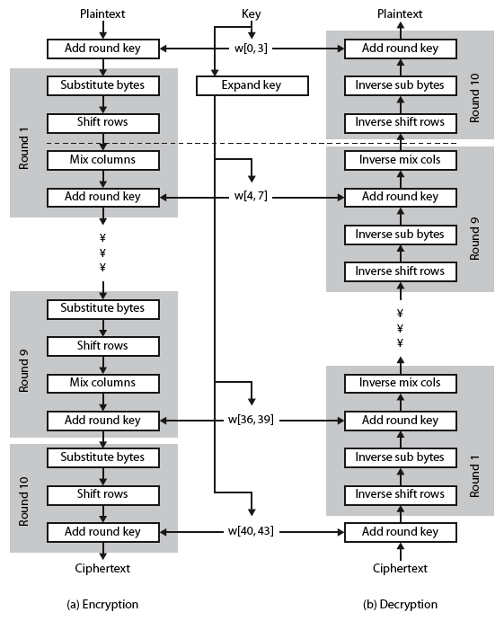
Rijndael
Notes:
Stallings Figure 5.1 shows the overall structure of AES, as detailed on the previous slide.

Slide 32
Byte Substitution
a simple substitution of each byte
uses one table of 16x16 bytes containing a permutation of all 256 8-bit values
each byte of state is replaced by byte indexed by row (left 4-bits) & column (right 4-bits)
eg. byte {95} is replaced by byte in row 9 column 5
which has value {2A}
S-box constructed using defined transformation of values in GF(2⁸)
designed to be resistant to all known attacks
Notes:
Now discuss each of the four stages used in AES. The Substitute bytes stage uses an S-box to perform a byte-by-byte substitution of the block. There is a single 8-bit wide S-box used on every byte. This S-box is a permutation of all 256 8-bit values, constructed using a transformation which treats the values as polynomials in GF(2⁸) – however it is fixed, so really only need to know the table when implementing. Decryption requires the inverse of the table. These tables are given in Stallings Table 4.5.
The table was designed to be resistant to known cryptanalytic attacks. Specifically, the Rijndael developers sought a design that has a low correlation between input bits and output bits, with the property that the output cannot be described as a simple mathematical function of the input, with no fixed points and no “opposite fixed points”.

Slide 33
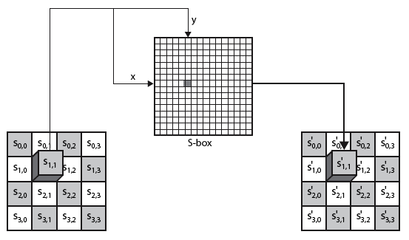
Byte Substitution
Notes:
As this diagram from Stallings Fig 5.4a shows, the Byte Substitution operates on each byte of state independently, with the input byte used to index a row/col in the table to retrieve the substituted value.

Slide 34
Shift Rows
a circular byte shift in each each
1st row is unchanged
2nd row does 1 byte circular shift to left
3rd row does 2 byte circular shift to left
4th row does 3 byte circular shift to left
decrypt inverts using shifts to right
since state is processed by columns, this step permutes bytes between the columns
Notes:
The ShiftRows stage provides a simple “permutation” of the data, whereas the other steps involve substitutions. Further, since the state is treated as a block of columns, it is this step which provides for diffusion of values between columns. It performs a circular rotate on each row of 0, 1, 2 & 3 places for respective rows. When decrypting it performs the circular shifts in the opposite direction for each row. This row shift moves an individual byte from one column to another, which is a linear distance of a multiple of 4 bytes, and ensures that the 4 bytes of one column are spread out to four different columns.

Slide 35
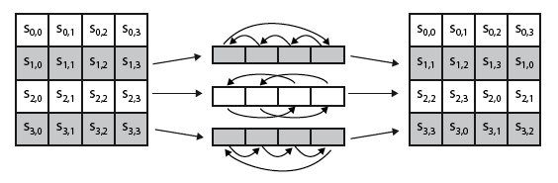
Shift Rows
Notes:
Stalling Figure 5.5a illustrates the Shift Rows permutation.

Slide 36

Mix Columns
each column is processed separately
each byte is replaced by a value dependent on all 4 bytes in the column
effectively a matrix multiplication in GF(2⁸) using prime poly m(x) =x⁸+x⁴+x³+x+1
Notes:
The MixColumns stage is a substitution that makes use of arithmetic over GF(2^8). Each byte of a column is mapped into a new value that is a function of all four bytes in that column. It is designed as a matrix multiplication where each byte is treated as a polynomial in GF(2⁸). The inverse used for decryption involves a different set of constants.
The constants used are based on a linear code with maximal distance between code words – this gives good mixing of the bytes within each column. Combined with the “shift rows” step provides good avalanche, so that within a few rounds, all output bits depend on all input bits.

Slide 37
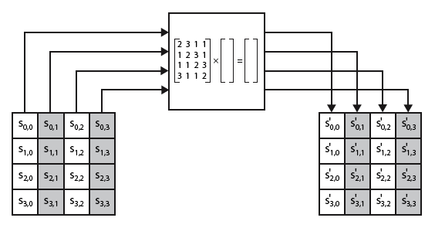
Mix Columns
Notes:
Stalling Figure 5.5b illustrates the Mix Columns transformation.

Slide 38
Mix Columns
can express each col as 4 equations
to derive each new byte in col
decryption requires use of inverse matrix
with larger coefficients, hence a little harder
have an alternate characterisation
each column a 4-term polynomial
with coefficients in GF(2⁸)
and polynomials multiplied modulo (x⁴+1)
Notes:
In practise, you implement Mix Columns by expressing the transformation on each column as 4 equations (Stallings equation 5.4) to compute the new bytes for that column. This computation only involves shifts, XORs & conditional XORs (for the modulo reduction).
The decryption computation requires the use of the inverse of the matrix, which has larger coefficients, and is thus potentially a little harder & slower to implement.
The designers & the AES standard provide an alternate characterisation of Mix Columns, which treats each column of State to be a four-term polynomial with coefficients in GF(2⁸). Each column is multiplied by a fixed polynomial a(x) given in Stallings eqn 5.7. Whilst this is useful for analysis of the stage, the matrix description is all that’s required for implementation.

Slide 39
Add Round Key
XOR state with 128-bits of the round key
again processed by column (though effectively a series of byte operations)
inverse for decryption identical
since XOR own inverse, with reversed keys
designed to be as simple as possible
a form of Vernam cipher on expanded key
requires other stages for complexity / security
Notes:
Lastly is the Add Round Key stage which is a simple bitwise XOR of the current block with a portion of the expanded key. Note this is the only step which makes use of the key and obscures the result, hence MUST be used at start and end of each round, since otherwise could undo effect of other steps. But the other steps provide confusion/diffusion/non-linearity. That us you can look at the cipher as a series of XOR with key then scramble/permute block repeated. This is efficient and highly secure it is believed.

Slide 40
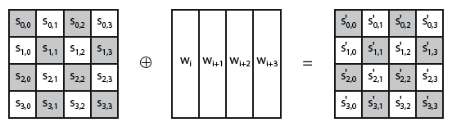
Add Round Key
Notes:
Stallings Figure 5.4b illustrates the Add Round Key stage, which like Byte Substitution, operates on each byte of state independently.

Slide 41
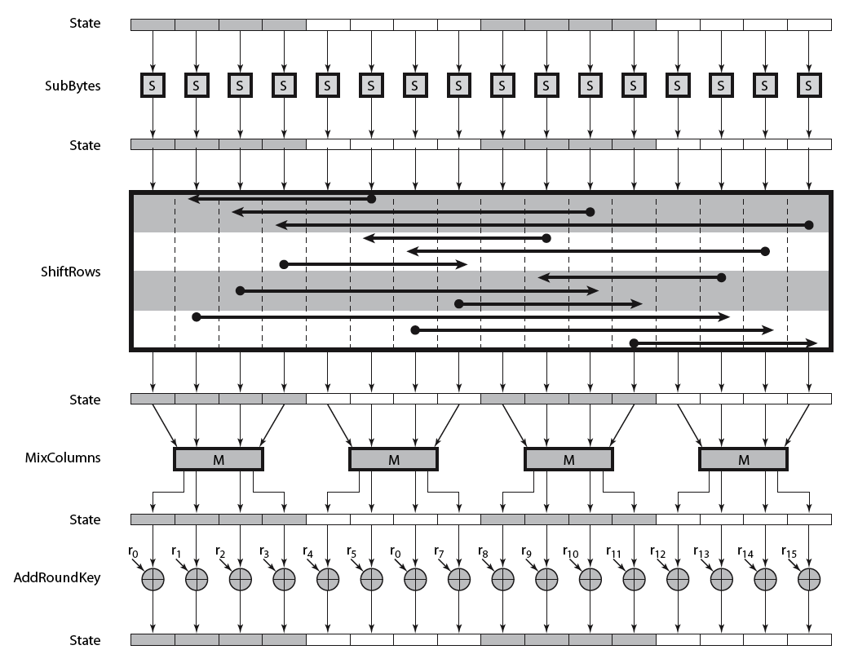
AES Round
Notes:
Can thus now view all the internal details of the AES round, showing how each byte of the state is manipulated, as shown in Stallings Figure 5.3.

Slide 42
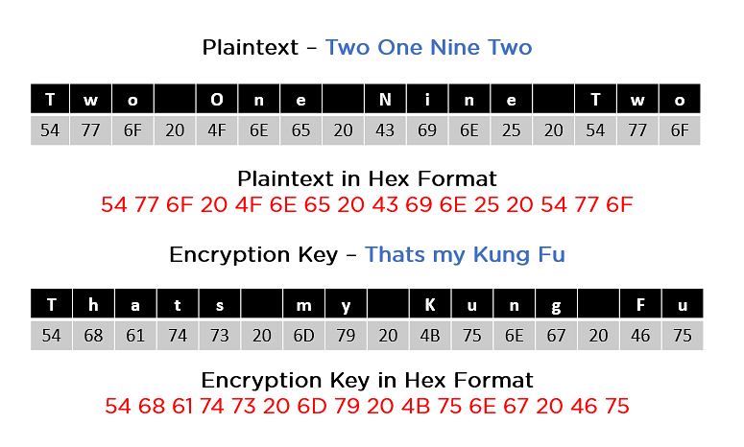
EXAMPLE

Slide 43
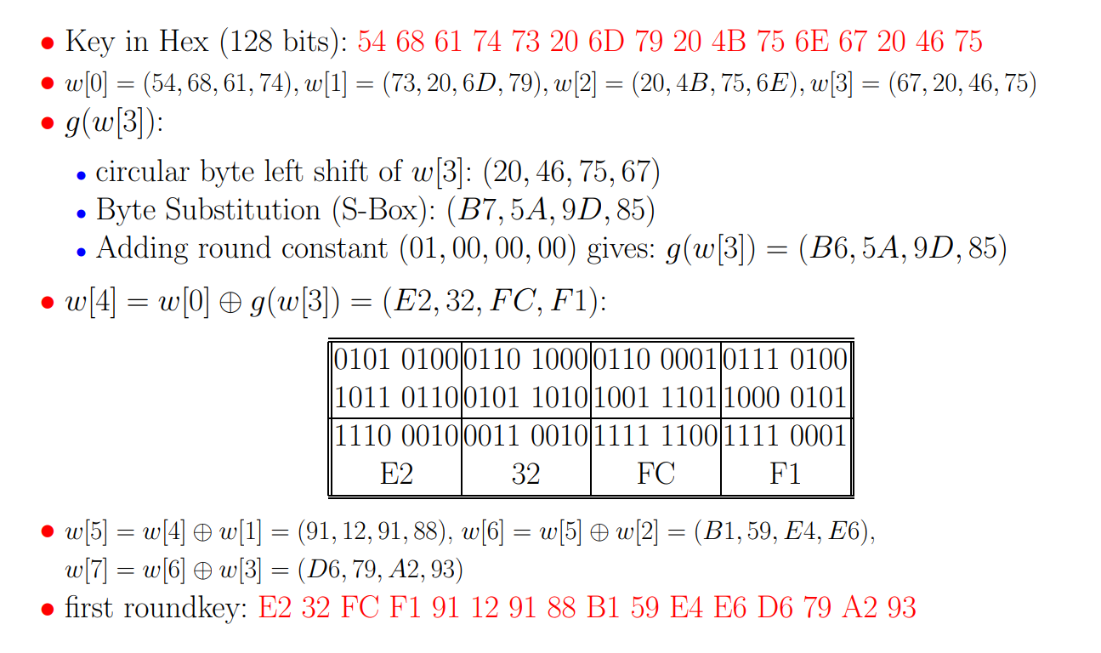
Key Generation For First Round

Slide 44
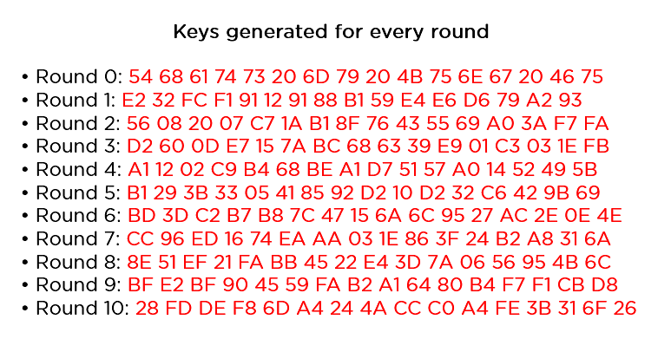
Key Generation For All Rounds

Slide 45
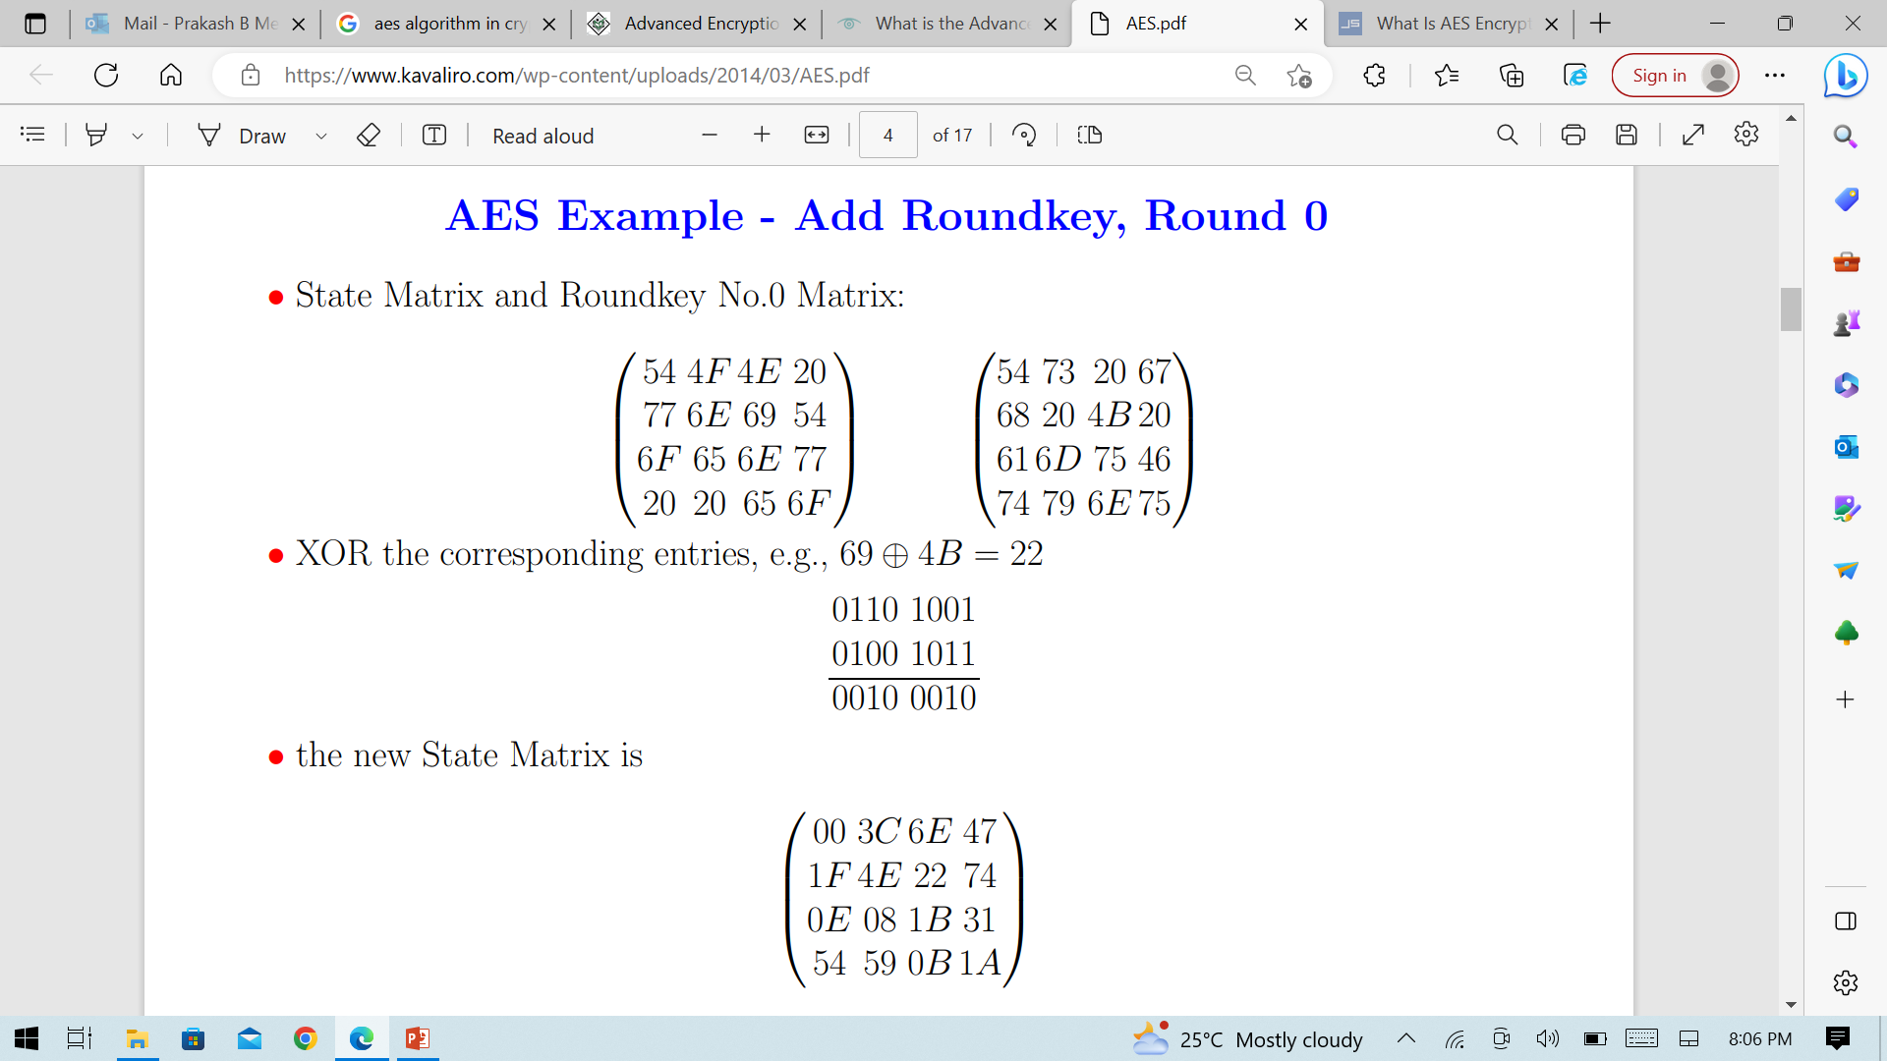
Add Round Key

Slide 46
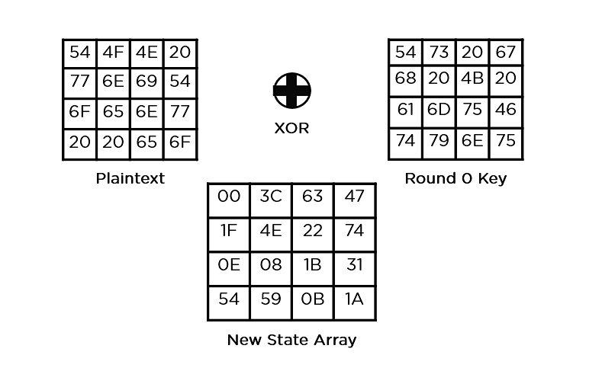
Add Round Key

Slide 47
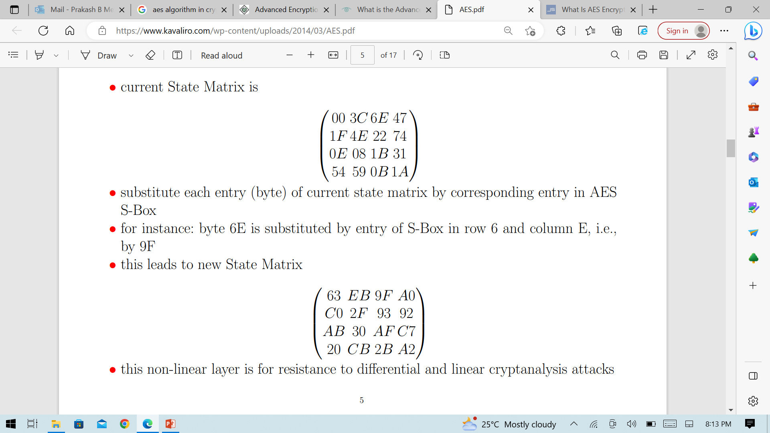
Substitute Bytes

Slide 48
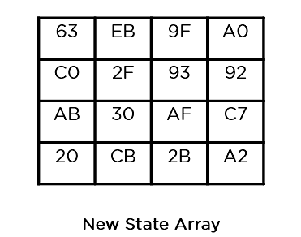
Substitute Bytes

Slide 49
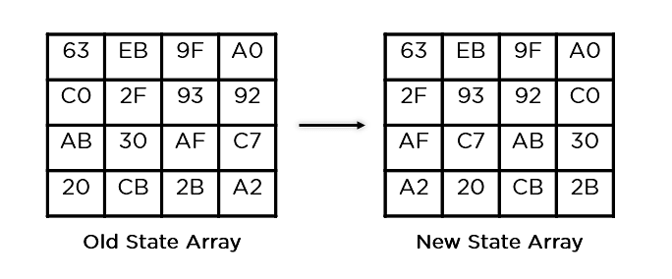
Shift Rows

Slide 50
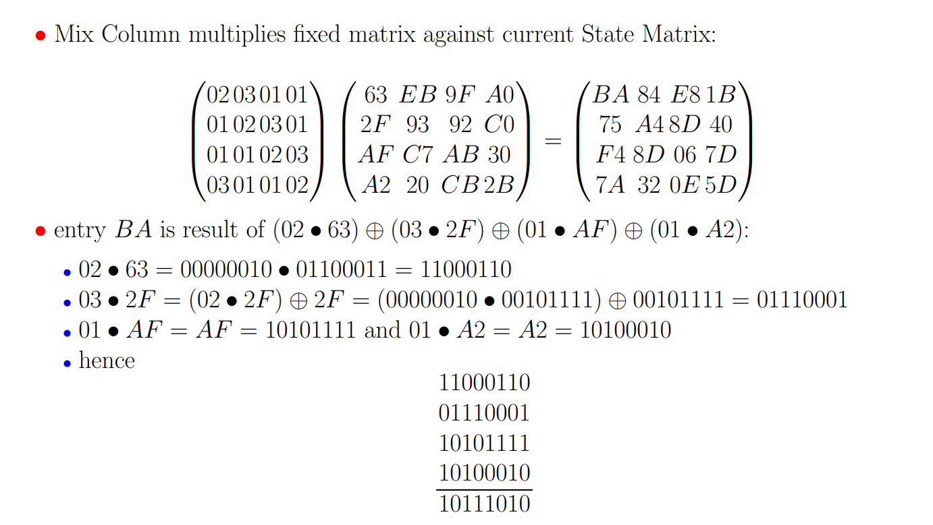
Mix Columns

Slide 51
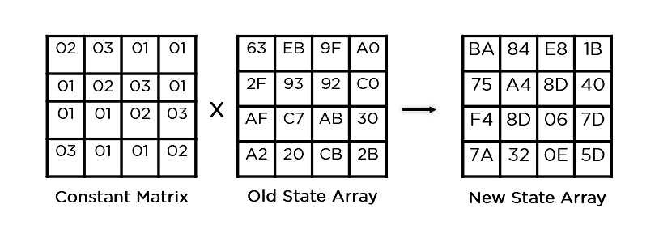
Mix Columns

Slide 52
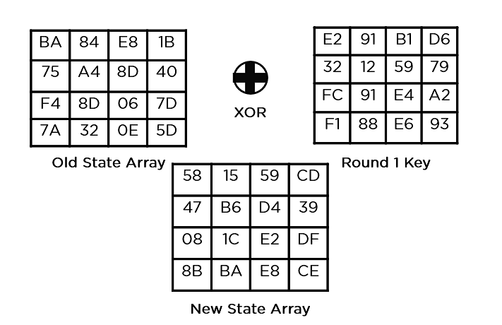
Add Round Key

Slide 53
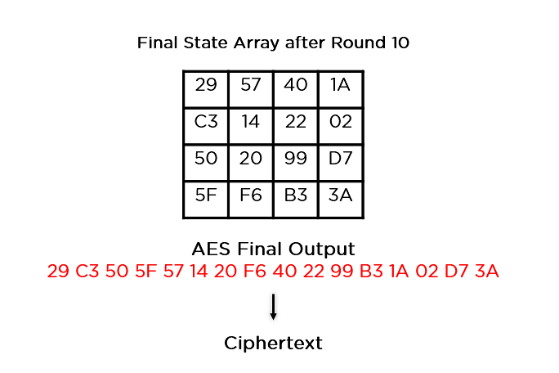
Final State

Slide 54
AES Key Expansion
takes 128-bit (16-byte) key and expands into array of 44/52/60 32-bit words
start by copying key into first 4 words
then loop creating words that depend on values in previous & 4 places back
in 3 of 4 cases just XOR these together
1st word in 4 has rotate + S-box + XOR round constant on previous, before XOR 4th back
Notes:
The AES key expansion algorithm takes as input a 4-word (16-byte) key and produces a linear array of words, providing a 4-word round key for the initial AddRoundKey stage and each of the 10/12/14 rounds of the cipher. It involves copying the key into the first group of 4 words, and then constructing subsequent groups of 4 based on the values of the previous & 4th back words. The first word in each group of 4 gets “special treatment” with rotate + S-box + XOR constant on the previous word before XOR’ing the one from 4 back. In the 256-bit key/14 round version, there’s also an extra step on the middle word.

Slide 55
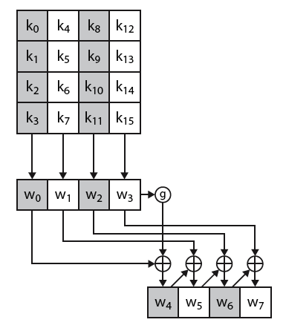
AES Key Expansion
Notes:
The first block of the AES Key Expansion is shown here in Stallings Figure 5.6. It shows each group of 4 bytes in the key being assigned to the first 4 words, then the calculation of the next 4 words based on the values of the previous 4 words, which is repeated enough times to create all the necessary subkey information.

Slide 56
Key Expansion Rationale
designed to resist known attacks
design criteria included
knowing part key insufficient to find many more
invertible transformation
fast on wide range of CPU’s
use round constants to break symmetry
diffuse key bits into round keys
enough non-linearity to hinder analysis
simplicity of description
Notes:
The Rijndael developers designed the expansion key algorithm to be resistant to known cryptanalytic attacks. It is designed to be simple to implement, but by using round constants break symmetries, and make it much harder to deduce other key bits if just some are known (but once have as many consecutive bits as are in key, can then easily recreate the full expansion). The design criteria used are listed above.

Slide 57
AES Decryption
AES decryption is not identical to encryption since steps done in reverse
but can define an equivalent inverse cipher with steps as for encryption
but using inverses of each step
with a different key schedule
works since result is unchanged when
swap byte substitution & shift rows
swap mix columns & add (tweaked) round key
Notes:
The AES decryption cipher is not identical to the encryption cipher (Stallings Figure 5.1). The sequence of transformations for decryption differs from that for encryption, although the form of the key schedules for encryption and decryption is the same. This has the disadvantage that two separate software or firmware modules are needed for applications that require both encryption and decryption. There is, however, an equivalent version of the decryption algorithm that has the same structure as the encryption algorithm, with the same sequence of transformations as the encryption algorithm (with transformations replaced by their inverses). To achieve this equivalence,a change in key schedule is needed.
By constructing an equivalent inverse cipher with steps in same order as for encryption, we can derive a more efficient implementation. Clearly swapping the byte substitutions and shift rows has no effect, since work just on bytes. Swapping the mix columns and add round key steps requires the inverse mix columns step be applied to the round keys first – this makes the decryption key schedule a little more complex with this construction, but allows the use of same h/w or s/w for the data en/decrypt computation.

Slide 58
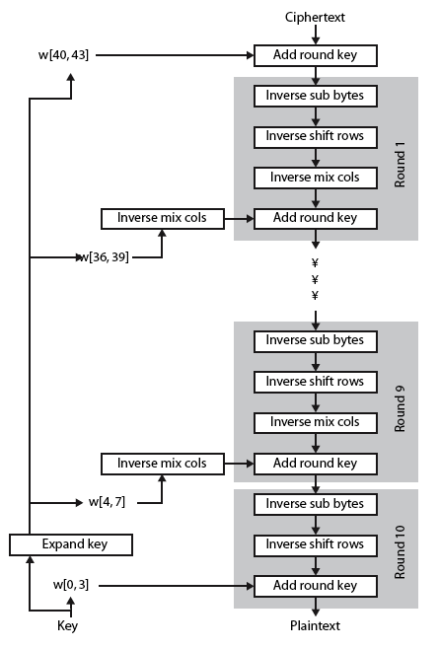
AES Decryption
Notes:
Illustrate the equivalent inverse cipher with Stallings Figure 5.7.

Slide 59
Implementation Aspects
can efficiently implement on 8-bit CPU
byte substitution works on bytes using a table of 256 entries
shift rows is simple byte shift
add round key works on byte XOR’s
mix columns requires matrix multiply in GF(2⁸) which works on byte values, can be simplified to use table lookups & byte XOR’s
Notes:
AES can be implemented very efficiently on an 8-bit processor.
AddRoundKey is a bytewise XOR operation.
ShiftRows is a simple byte shifting operation.
SubBytes operates at the byte level and only requires a lookup of a 256 byte table S.
MixColumns (matrix multiply) can be implemented as byte XOR’s & table lookups with a 2nd 256 byte table X2, using the formulae shown in Stallings equation 5.9.

Slide 60
Implementation Aspects
can efficiently implement on 32-bit CPU
redefine steps to use 32-bit words
can precompute 4 tables of 256-words
then each column in each round can be computed using 4 table lookups + 4 XORs
at a cost of 4Kb to store tables
designers believe this very efficient implementation was a key factor in its selection as the AES cipher
Notes:
AES can also be very efficiently implemented on an 32-bit processor, by rewriting the stage transformation to use 4 table lookups & 4 XOR’s per column of state. These tables can be computed in advance using the formulae shown in the text, and need 4Kb to store.
The developers of Rijndael believe that this compact, efficient implementation was probably one of the most important factors in the selection of Rijndael for AES.

Slide 61
Greatest Common Divisor (GCD)
a common problem in number theory
GCD (a,b) of a and b is the largest number that divides evenly into both a and b
eg GCD(60,24) = 12
often want no common factors (except 1) and hence numbers are relatively prime
eg GCD(8,15) = 1
hence 8 & 15 are relatively prime

Slide 62
Euclid's GCD Algorithm
an efficient way to find the GCD(a,b)
uses theorem that:
GCD(a,b) = GCD(b, a mod b)
With any integers a,b and a>=b>=0
GCD (55,22)=GCD(22,55 mod 22)=gcd(22,11)=11.
Where a=kb+r = r(mod b) or a mod b = r.
Euclid's Algorithm to compute GCD(a,b):
Recursive fn. Euclid(a,b)
If b=0 then
return a;
Else returnEuclid (b,a mod b)
Notes:
Euclid's Algorithm is derived from the observation that if a & b have a common factor d (ie. a=m.d & b=n.d) then d is also a factor in any difference between them, vis: a-p.b = (m.d)-p.(n.d) = d.(m-p.n). Euclid's Algorithm keeps computing successive differences until it vanishes, at which point that divisor has been reached.

Slide 63
Extended Euclid's GCD Algorithm
Imp. Finitefield in Encryption algorithm such as RSA.
For Given integers a,b
The Extended Euclidean algorithm not only calculate the greatest common divisor d but also two additional integers x and y.
i.e., ax+by=d=gcd(a,b)
So, E.E A ends with remainder are 0 but the GCD of a,b is d= gcd (a,b)= rn
Therefore x=xn; y = yn.

Slide 64
Finding Inverses
EXTENDED EUCLID(m, b)
1. (A1, A2, A3)=(1, 0, m);
(B1, B2, B3)=(0, 1, b)
2. if B3 = 0
return A3 = gcd(m, b); no inverse
3. if B3 = 1
return B3 = gcd(m, b); B2 = b^{–1} mod m
4. Q = A3 div B3
5. (T1, T2, T3)=(A1 – Q B1, A2 – Q B2, A3 – Q B3)
6. (A1, A2, A3)=(B1, B2, B3)
7. (B1, B2, B3)=(T1, T2, T3)
8. goto 2
Notes:
An important problem is to find multiplicative inverses in such finite fields. Can show that such inverses always exist, & can extend the Euclidean algorithm to find them as shown. See text for discussion as to why this works.

Slide 65
Inverse of 550 in GF(1759)
Q | A1 | A2 | A3 | B1 | B2 | B3
— | 1 | 0 | 1759 | 0 | 1 | 550
3 | 0 | 1 | 550 | 1 | –3 | 109
5 | 1 | –3 | 109 | –5 | 16 | 5
21 | –5 | 16 | 5 | 106 | –339 | 4
1 | 106 | –339 | 4 | –111 | 355 | 1
Notes:
Example showing how to find the inverse of 550 in GF(1759), from Stallings Table 4.4.

Slide 66
Prime Numbers
Prime numbers only have divisors of 1 and self
they cannot be written as a product of other numbers
note: 1 is prime, but is generally not of interest
eg. 2,3,5,7 are prime, 4,6,8,9,10 are not
prime numbers are central to number theory
list of prime number less than 200 is:
2 3 5 7 11 13 17 19 23 29 31 37 41 43 47 53 59 61 67 71 73 79 83 89 97 101 103 107 109 113 127 131 137 139 149 151 157 163 167 173 179 181 191 193 197 199

Slide 67

Prime Factorisation
to factor a number n is to write it as a product of other numbers: n=a × b × c
note that factoring a number is relatively hard compared to multiplying the factors together to generate the number
the prime factorisation of a number n is when its written as a product of primes
eg. 91=7×13 ; 3600=2⁴×3²×5²
Notes:
The idea of "factoring" a number is important - finding numbers which divide into it. Taking this as far as can go, by factorising all the factors, we can eventually write the number as a product of (powers of) primes - its prime factorisation.

Slide 68
Relatively Prime Numbers & GCD
two numbers a, b are relatively prime if have no common divisors apart from 1
eg. 8 & 15 are relatively prime since factors of 8 are 1,2,4,8 and of 15 are 1,3,5,15 and 1 is the only common factor
conversely can determine the greatest common divisor by comparing their prime factorizations and using least powers
eg. 300=2¹×3¹×5² 18=2¹×3²
hence GCD(18,300)=2¹×3¹×5⁰=6

Slide 69
Fermat's Theorem
If p is prime and a is a positive integer not divisible by p, then
a^{p-1} mod p = 1
While gcd(a,p)=1
also known as Fermat’s Little Theorem
Alternatively We can say
If p is a prime and a is a positive integer, then a power n = a (mod p)
Two no.are relatively prime if they have no prime factors in common.i.e., only one divisor and GCD is also 1.
useful in public key and primality testing

Slide 70
Euler Totient Function ø(n)
when doing arithmetic modulo n
complete set of residues is: 0..n-1
reduced set of residues is those numbers (residues) which are relatively prime to n
eg for n=10,
complete set of residues is {0,1,2,3,4,5,6,7,8,9}
reduced set of residues is {1,3,7,9}
number of elements in reduced set of residues is called the Euler Totient Function ø(n)

Slide 71
Euler Totient Function ø(n)
to compute ø(n) need to count number of elements to be excluded
in general need prime factorization, but
for p (p prime) ø(p) = p-1
for p.q (p,q prime) ø(p.q) = (p-1)(q-1)
eg.
ø(37) = 36
ø(21) = (3–1)×(7–1) = 2×6 = 12

Slide 72
Euler's Theorem
a generalisation of Fermat's Theorem
a^{ø(n)}mod N = 1
where gcd(a,N)=1 for every a,n are relatively prime.
eg.
a=3;n=10; ø(10)=4;
hence 3⁴ = 81 = 1 mod 10
a=2;n=11; ø(11)=10;
hence 2¹⁰ = 1024 = 1 mod 11

Slide 73
Primality Testing
often need to find large prime numbers
traditionally done using trial division
ie. divide by all numbers (primes) in turn less than the square root of the number
only works for small numbers
alternatively can use statistical primality tests based on properties of primes
for which all primes numbers satisfy property
but some composite numbers, called pseudo-primes, also satisfy the property

Slide 74
Miller Rabin Algorithm
a test based on Fermat’s Theorem
algorithm is:
TEST (n) is:
1. Find integers k, q, k > 0, q odd, so that (n–1)=2^{k}q
2. Select a random integer a, 1<a<n–1
3. if a^{q} mod n = 1 then return (“maybe prime");
4. for j = 0 to k – 1 do
5. if (a^{2jq} mod n = n-1)
then return(" maybe prime ")
6. return ("composite")

Slide 75
Probabilistic Considerations
if Miller-Rabin returns “composite” the number is definitely not prime
otherwise is a prime or a pseudo-prime
chance it detects a pseudo-prime is < ¼
hence if repeat test with different random a then chance n is prime after t tests is:
Pr(n prime after t tests) = 1-4^{-t}
eg. for t=10 this probability is > 0.99999

Slide 76
Prime Distribution
prime number theorem states that primes occur roughly every (ln n) integers
since can immediately ignore evens and multiples of 5, in practice only need test 0.4 ln(n) numbers of size n before locate a prime
note this is only the “average” sometimes primes are close together, at other times are quite far apart

Slide 77
Chinese Remainder Theorem
used to speed up modulo computations
working modulo a product of numbers
eg. mod M = m₁m₂..m_{k}
Chinese Remainder theorem lets us work in each moduli m_{i} separately
since computational cost is proportional to size, this is faster than working in the full modulus M
Notes:
The CRT is so called because it is believed to have been discovered by the Chinese
mathematician Sun-Tse in around 100 AD.
It is very useful in speeding up some operations in the RSA public-key scheme.

Slide 78

Chinese Remainder Theorem
can implement CRT in several ways
It is possible to reconstruct the integers in a certain range from their resudues modulo to attain set of pairwise relatively prime moduli.
to compute (A mod M) we can first compute all (a_{i} mod m_{i}) separately and then combine results to get answer using:
Notes:
See worked examples in text.

Slide 79
Primitive Roots
from Euler’s theorem have a^{ø(n)}mod n=1
consider a^{m}mod n=1, GCD(a,n)=1
must exist for m= ø(n) but may be smaller
once powers reach m, cycle will repeat
if smallest is m= ø(n) then a is called a primitive root
if p is prime, then successive powers of a "generate" the group mod p
these are useful but relatively hard to find

Slide 80
Discrete Logarithms or Indices
the inverse problem to exponentiation is to find the discrete logarithm of a number modulo p
that is to find x where a^{x} = b mod p
written as x=log_{a} b mod p or x=ind_{a,p}(b)
if a is a primitive root then always exists, otherwise may not
x = log₃ 4 mod 13 (x st 3^{x} = 4 mod 13) has no answer
x = log₂ 3 mod 13 = 4 by trying successive powers
whilst exponentiation is relatively easy, finding discrete logarithms is generally a hard problem
Notes:
Discrete logs (or indices) share the properties of normal logarithms, and are quite useful. However whilst exponentiation is relatively easy, finding discrete logs is not, in fact is as hard as factoring a number.
It is the inverse problem to exponentiation, and is an example of a problem thats "easy" one way (raising a number to a power), but "hard" the other (finding what power a number is raised to giving the desired answer). Problems with this type of asymmetry are very rare, but are of critical usefulness in modern cryptography.

Slide 81


